Slide 1
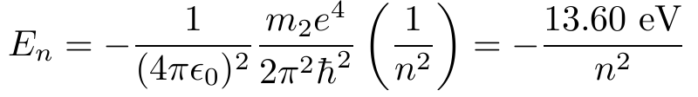
Correction to formula
Slide 16
Should be

